Slide 1
Multiple Inheritance

Slide 2
Multiple Inheritance
Multiple Inheritance is a feature of C++ where a class can inherit from more than one classes.

Slide 3
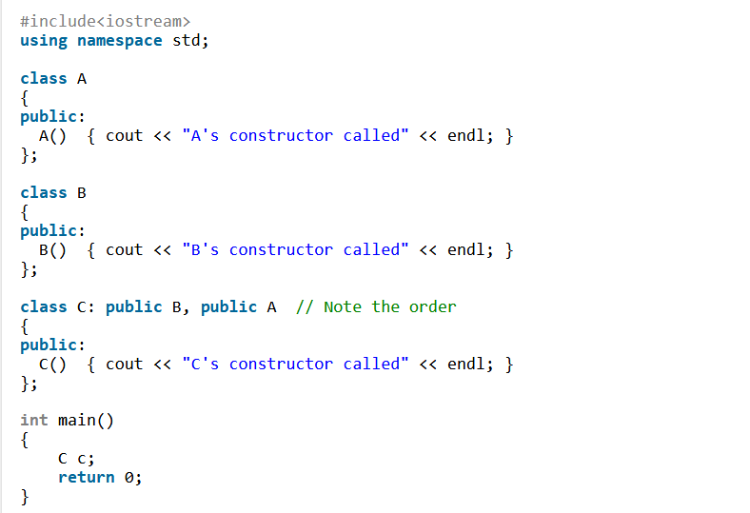

Slide 4
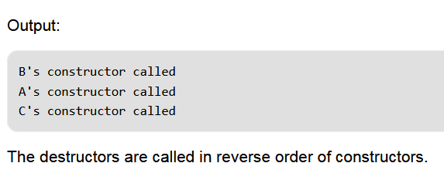

Slide 5
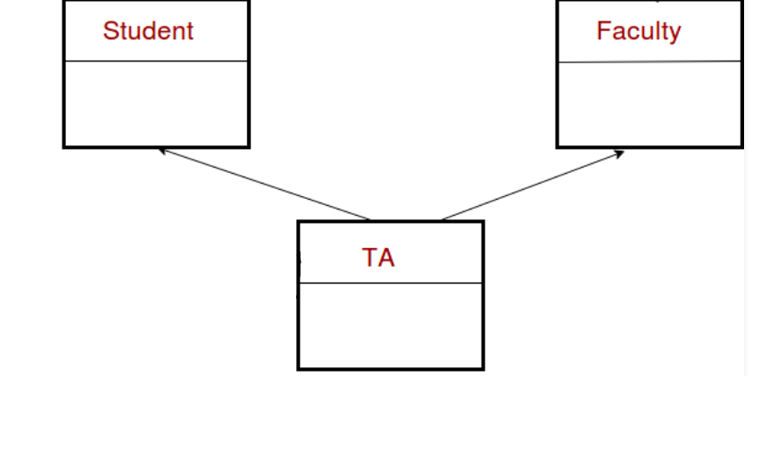

Slide 6
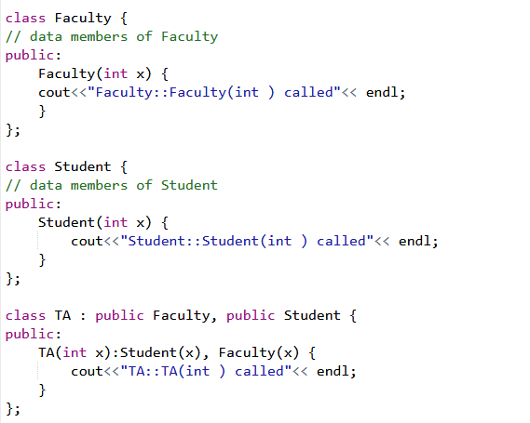

Slide 7
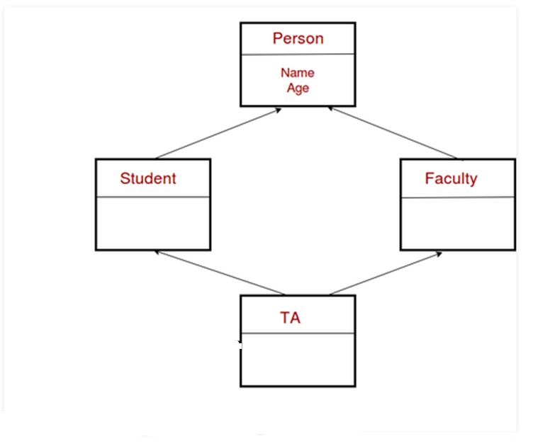

Slide 8
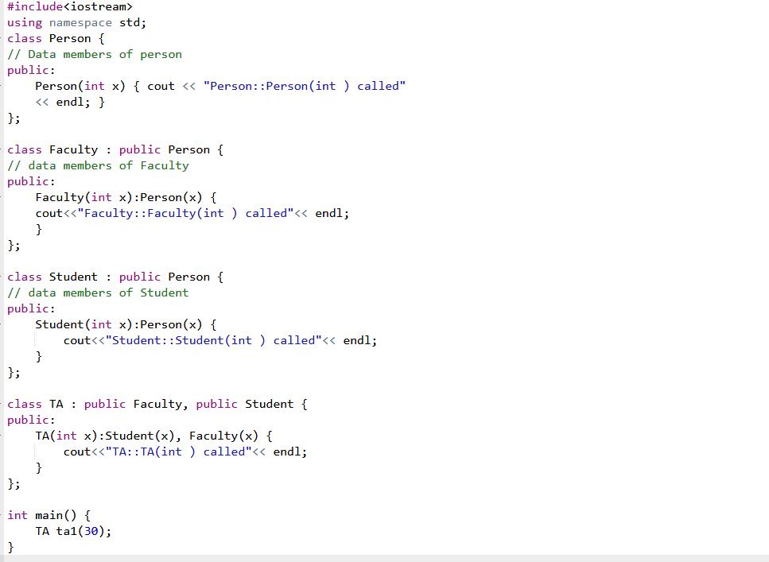

Slide 9
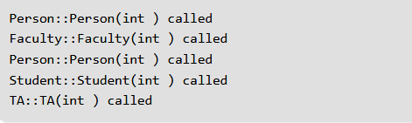

Slide 10
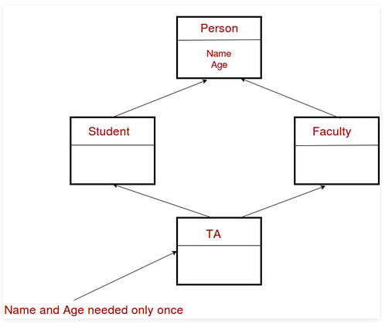

Slide 11
The diamond problem
The diamond problem occurs when two super-classes of a class have a common base class.
Constructor of ‘Person’ is called two times. Destructor of ‘Person’ will also be called two times when object ‘ta1’ is destructed. So object ‘ta1’ has two copies of all members of ‘Person’, this causes ambiguities.

Slide 12
Solution
The solution to this problem is ‘virtual’ keyword. We make the classes ‘Faculty’ and ‘Student’ as virtual base classes to avoid two copies of ‘Person’ in ‘TA’ class.

Slide 13
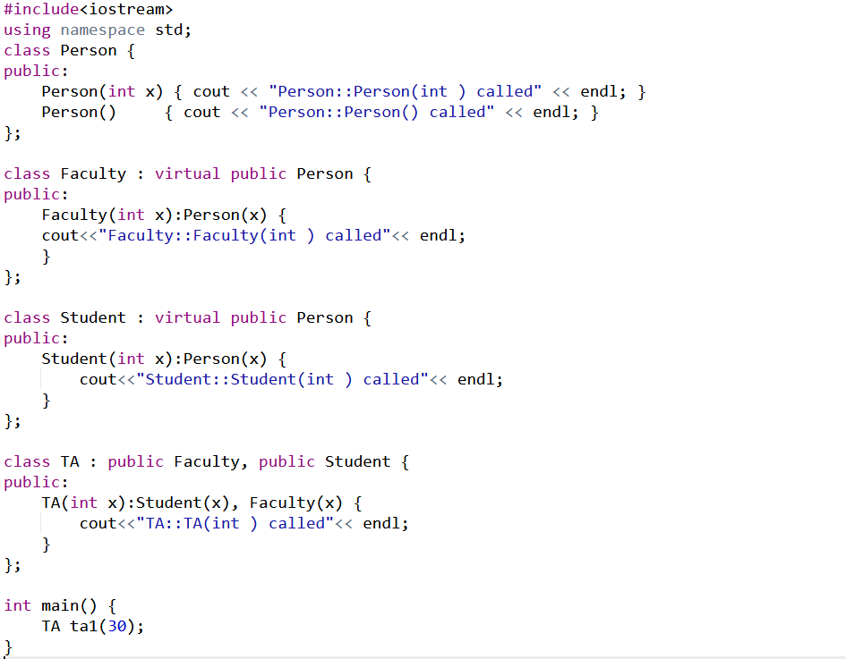

Slide 14
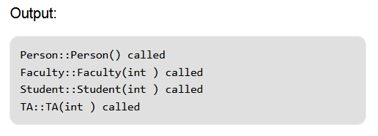

Slide 15
When we use ‘virtual’ keyword, the default constructor of grandparent class is called by default even if the parent classes explicitly call parameterized constructor.
One important thing to note in the above output is, the default constructor of ‘Person’ is called.

Slide 16
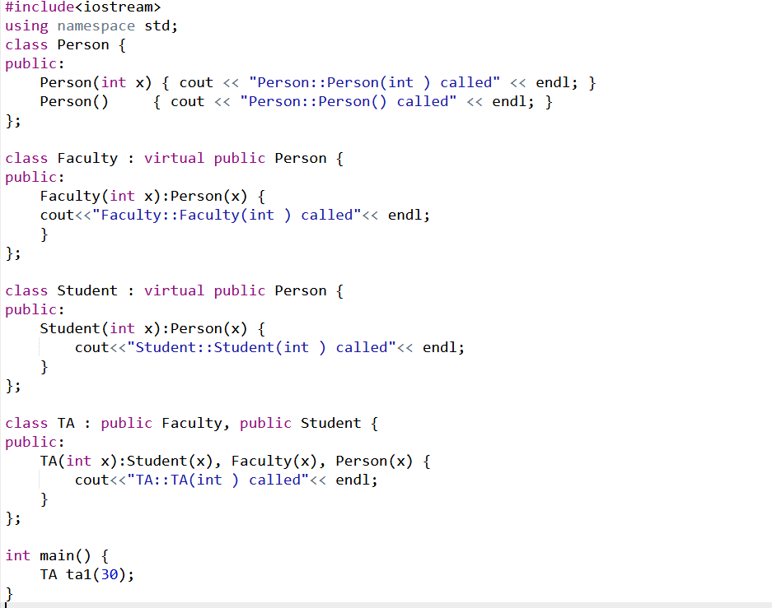

Slide 17
